Slide 1
Weather forecasting using python and gui
Name: Aarush Rastogi (RA2311026030038) and
Ipshita Singh(RA2311026030054)
Course: Btech Cse AIML-A
Subject: Advanced Programming Practice
Submitted to:

Slide 2
OVERVIEW OF THE PROJECT
Introduction
Project Overview
Technology used
Python libraries
Working
User interface
GUI
Fetching
Displaying
Benefits
Challenges
Future Enhancements
Conclusion

Slide 3

INTRODUCTION
The proposed system provides the weather of the different cities around the World.
In this system the user can view weather for which they search for.
The system can track local and national weather.
The proposed system uses Open Weather Map API.
Objective of the Project:
To create a Python-based weather forecasting program with a graphical user interface (GUI) for ease of use.

Slide 4
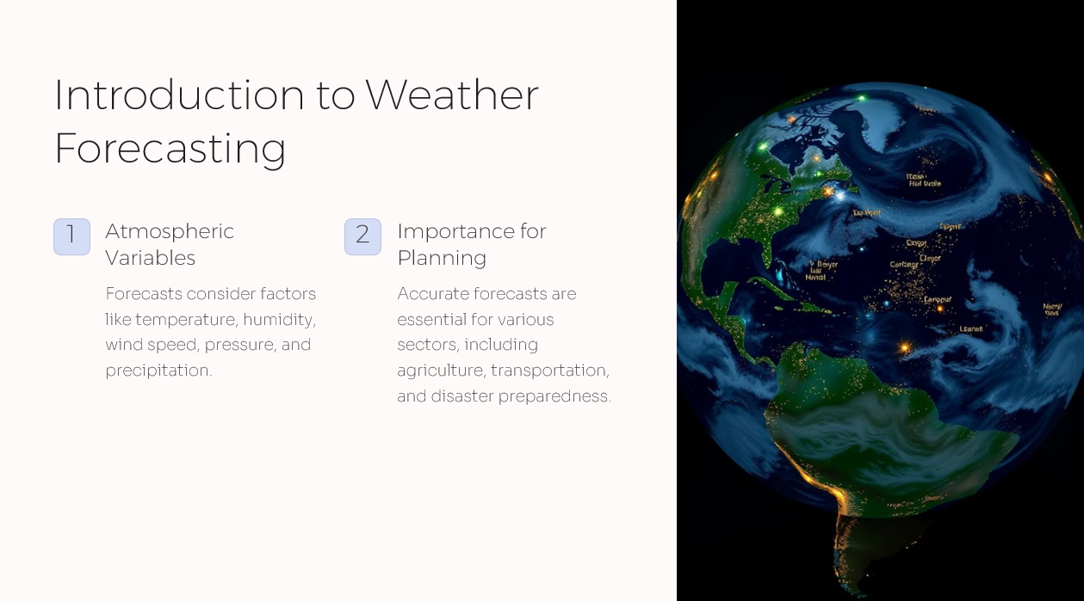

Slide 5
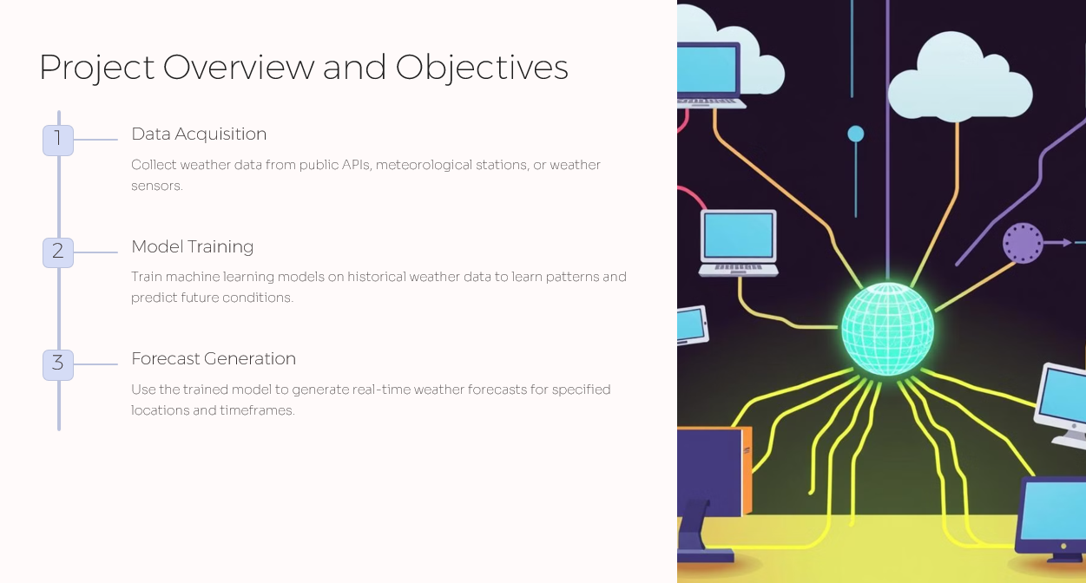

Slide 6
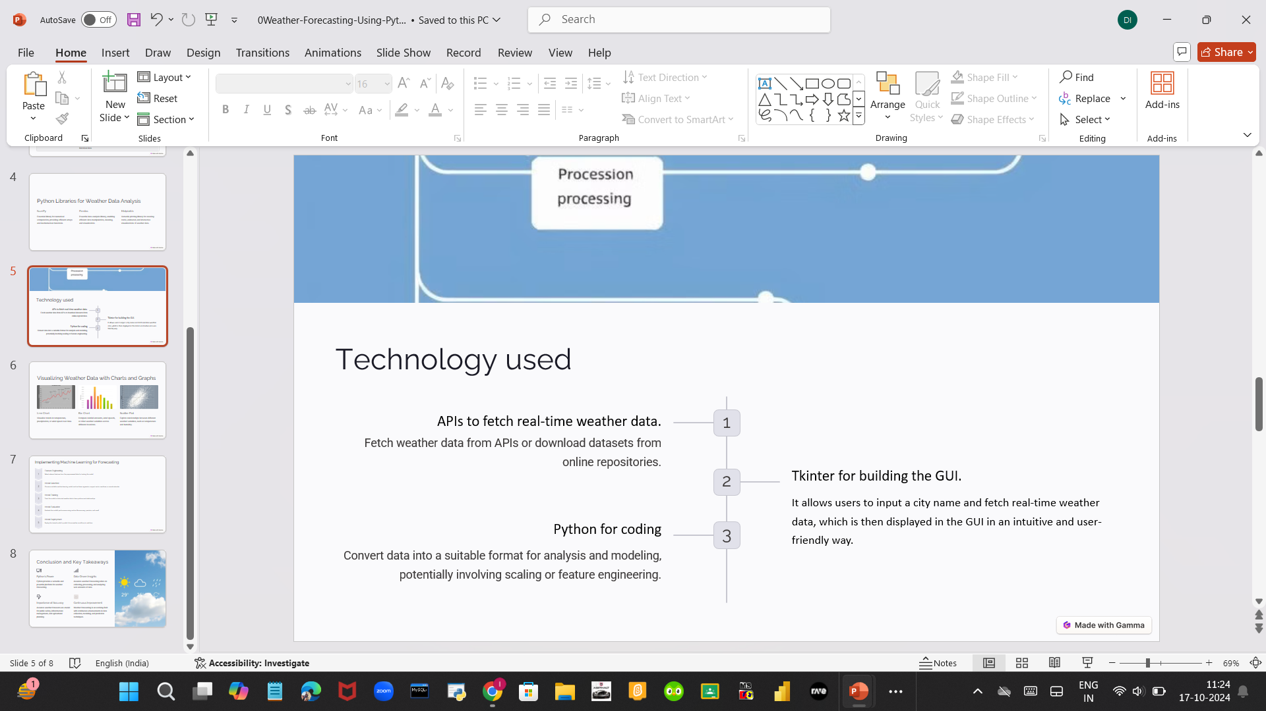

Slide 7
Python Libraries for Weather Data Analysis
Tkinter
PIL
ttkbootstrap
Tkinter is Python's standard GUI library that provides a wide range of tools to create graphical user interfaces, including widgets like buttons, labels, and text boxes. It is lightweight and easy to use, making it ideal for small to medium-scale desktop applications.
It allows developers to perform image processing tasks such as resizing, cropping, filtering, and converting images between formats, making it useful in multimedia applications.
It enhances the appearance of Tkinter applications by applying Bootstrap-like themes, making GUIs more visually appealing without extensive customization.

Slide 8
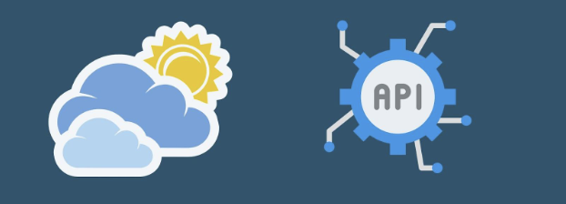
working
The user is asked to enter the name of the city.
User then clicks on Search which further calls the Open Weather API
Weather conditions of place which include Temperature and cloud pct are displayed.
If user wishes to search weather for other cities they can re-enter the city name in search bar and press enter.
If user wishes to exit, he can simply close the application.
In this system, we don’t need to setup weather station in each city on each country to get weather information. We can get those information including Temperature and Cloud pct by using weather API.

Slide 9
GUI INTERFACE DESIGN
GUI Layout Overview:
Input field for city name.
Buttons for “Fetch Weather” and “Exit.”
Textbox/Labels displaying weather information like temperature, humidity, and wind speed.

Slide 10
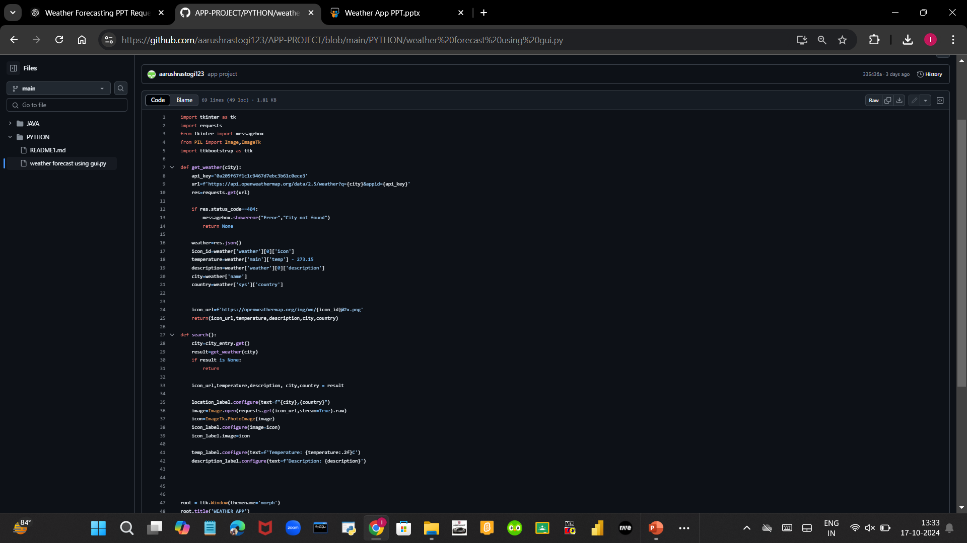
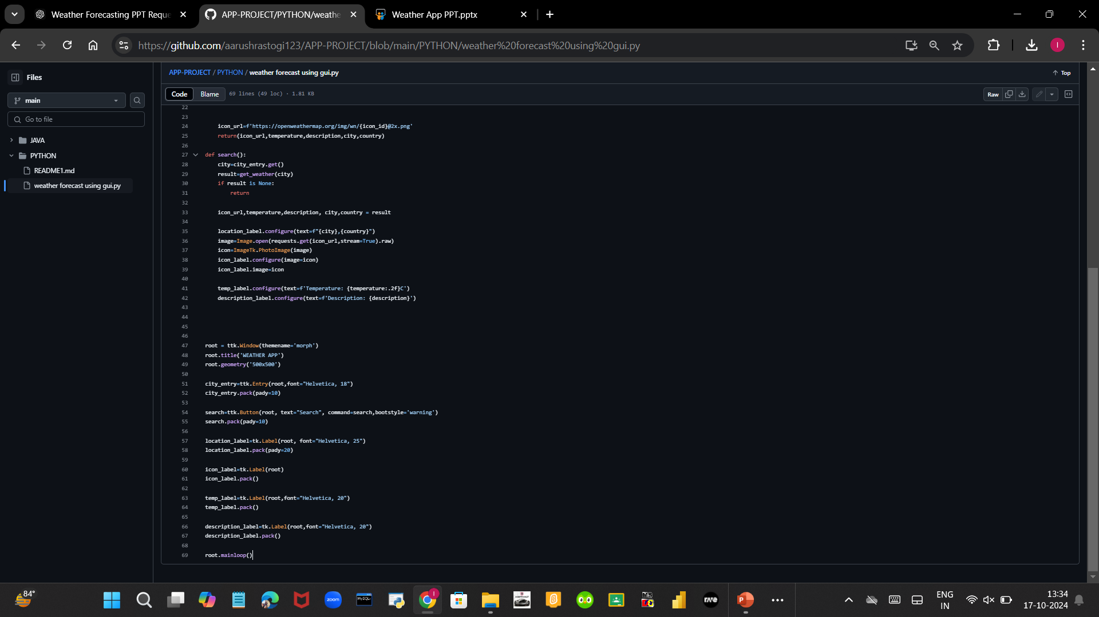
Gui fetching and displaying

Slide 11
BENEFITS
The weather app enables you to make better preparation for the day in relation to giving accurate daily weather.
We need Weather App to plan journeys ahead to plan meetings / commute timings.
A person travelling on the bus or train may need to check the weather in their destination city.
The system provides you with details of weather elements- Temprature and Cloud CPT.

Slide 12
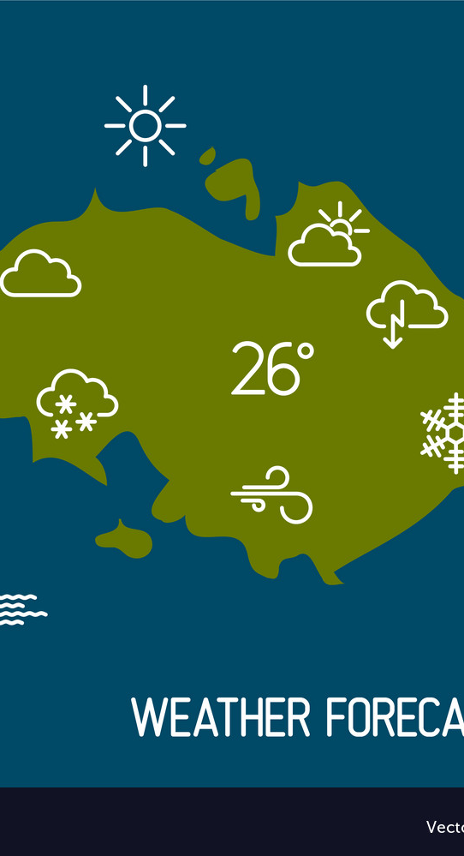
Challenges and Solutions
Challenges Faced:
Handling invalid city names.
API request errors (network issues, rate limits).
Solutions:
Implemented error handling using try-except
blocks.
Displaying meaningful error messages to the
user in the GUI.

Slide 13

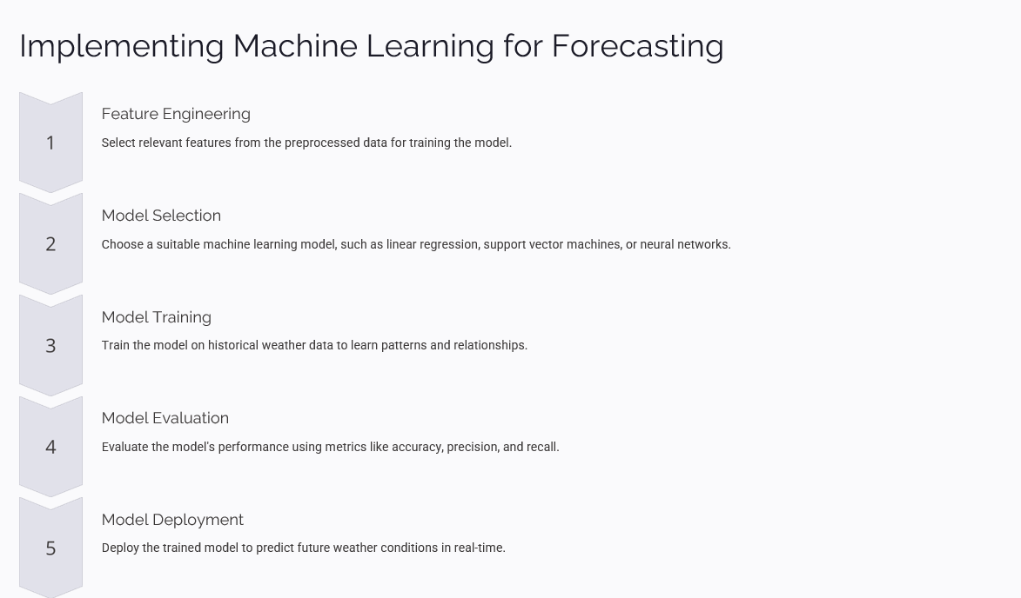

Slide 14
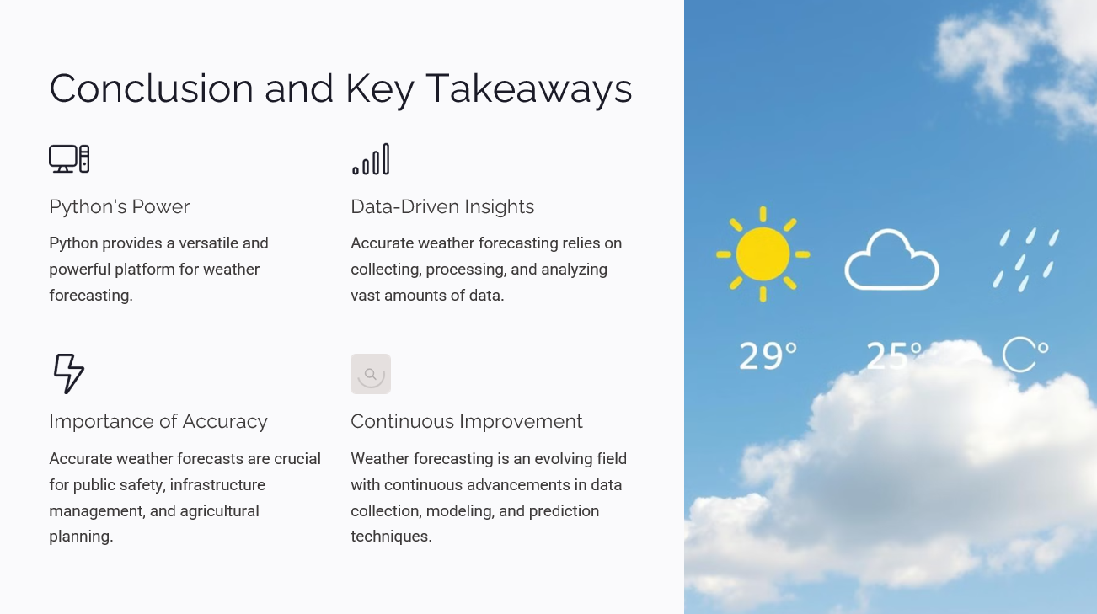

Slide 15
